Slide 1
Aquaculture in Freshwater
Understanding the Freshwater Aquaculture Industry

Slide 2
Introduction
Aquaculture can be conducted in various production systems, depending on the species being farmed and the environmental conditions. Some common production systems include pond culture, cage culture, raceway systems, recirculating aquaculture systems (RAS), and integrated multi-trophic aquaculture (IMTA).
Fish Farming, also known as aquaculture, is the practice of raising fish and other aquatic organisms in controlled environments. The types of fish farming can vary depending on the water source and the type of aquatic species being cultivated.

Slide 3
Types of fish farming in different waters:
Freshwater fish farming
Marine fish farming
Brackish water fish farming
Recirculating Aquaculture Systems (RAS)
Integrated Multi-Trophic Aquaculture (IMTA)
Rice-fish farming

Slide 4
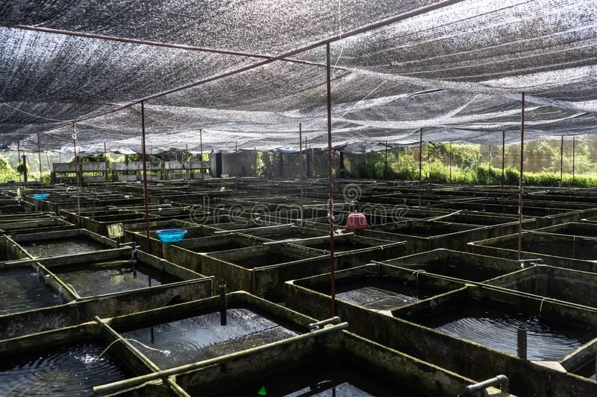
Freshwater fish farming
Freshwater fish farming, also known as freshwater aquaculture, involves the cultivation of fish species in man-made or natural freshwater environments. This type of aquaculture is widely practiced around the world and is an important source of food and income for many communities.

Slide 5
key aspects of freshwater fish farming
Fish Species: Various fish species are suitable for freshwater farming, depending on the local climate, water quality, and market demand. Common freshwater fish species raised in farms include tilapia, catfish, carp, trout, perch, and bass.
Pond Culture: Pond culture is one of the most common methods of freshwater fish farming. It involves creating artificial ponds or using existing natural water bodies to raise fish. Ponds can vary in size, and farmers manage water quality, feeding, and disease control to promote optimal fish growth.
Cage Culture: In cage culture, fish are kept in submerged cages or net enclosures placed in natural or man-made water bodies. Cage culture is often used for species like tilapia and catfish and allows fish to grow in their natural environment while being contained.

Slide 6
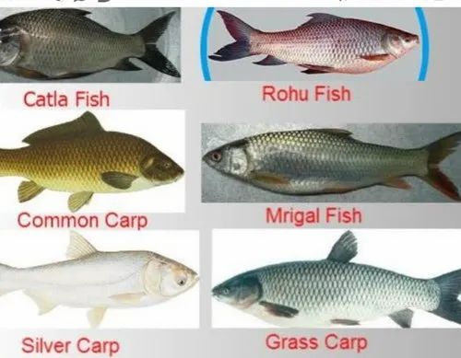
Some Fish Species that grow in fresh water
Tilapia
Catfish
Carp
Trout
Bass
Perch
Pike
Crappie
Catla

Slide 7
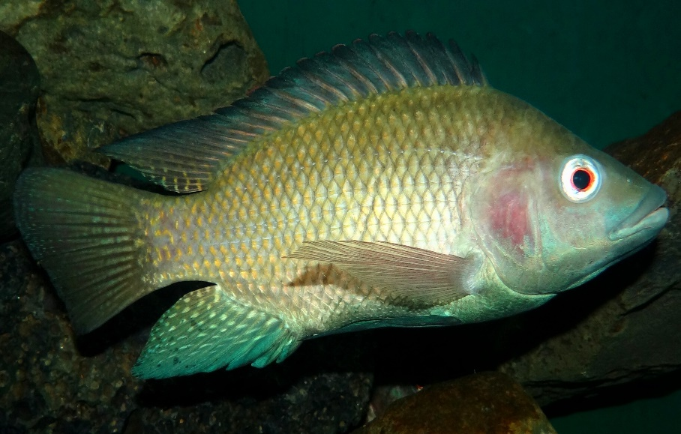
Tilapai
Tilapia is a popular freshwater fish known for its rapid growth and mild taste. It is widely farmed in aquaculture systems around the world.
Temperature in the range of 24-32°C.
Dissolved oxygen(DO) level is below 2.3 mg/L
pH to be in the range of 5.0 to 10.0

Slide 8
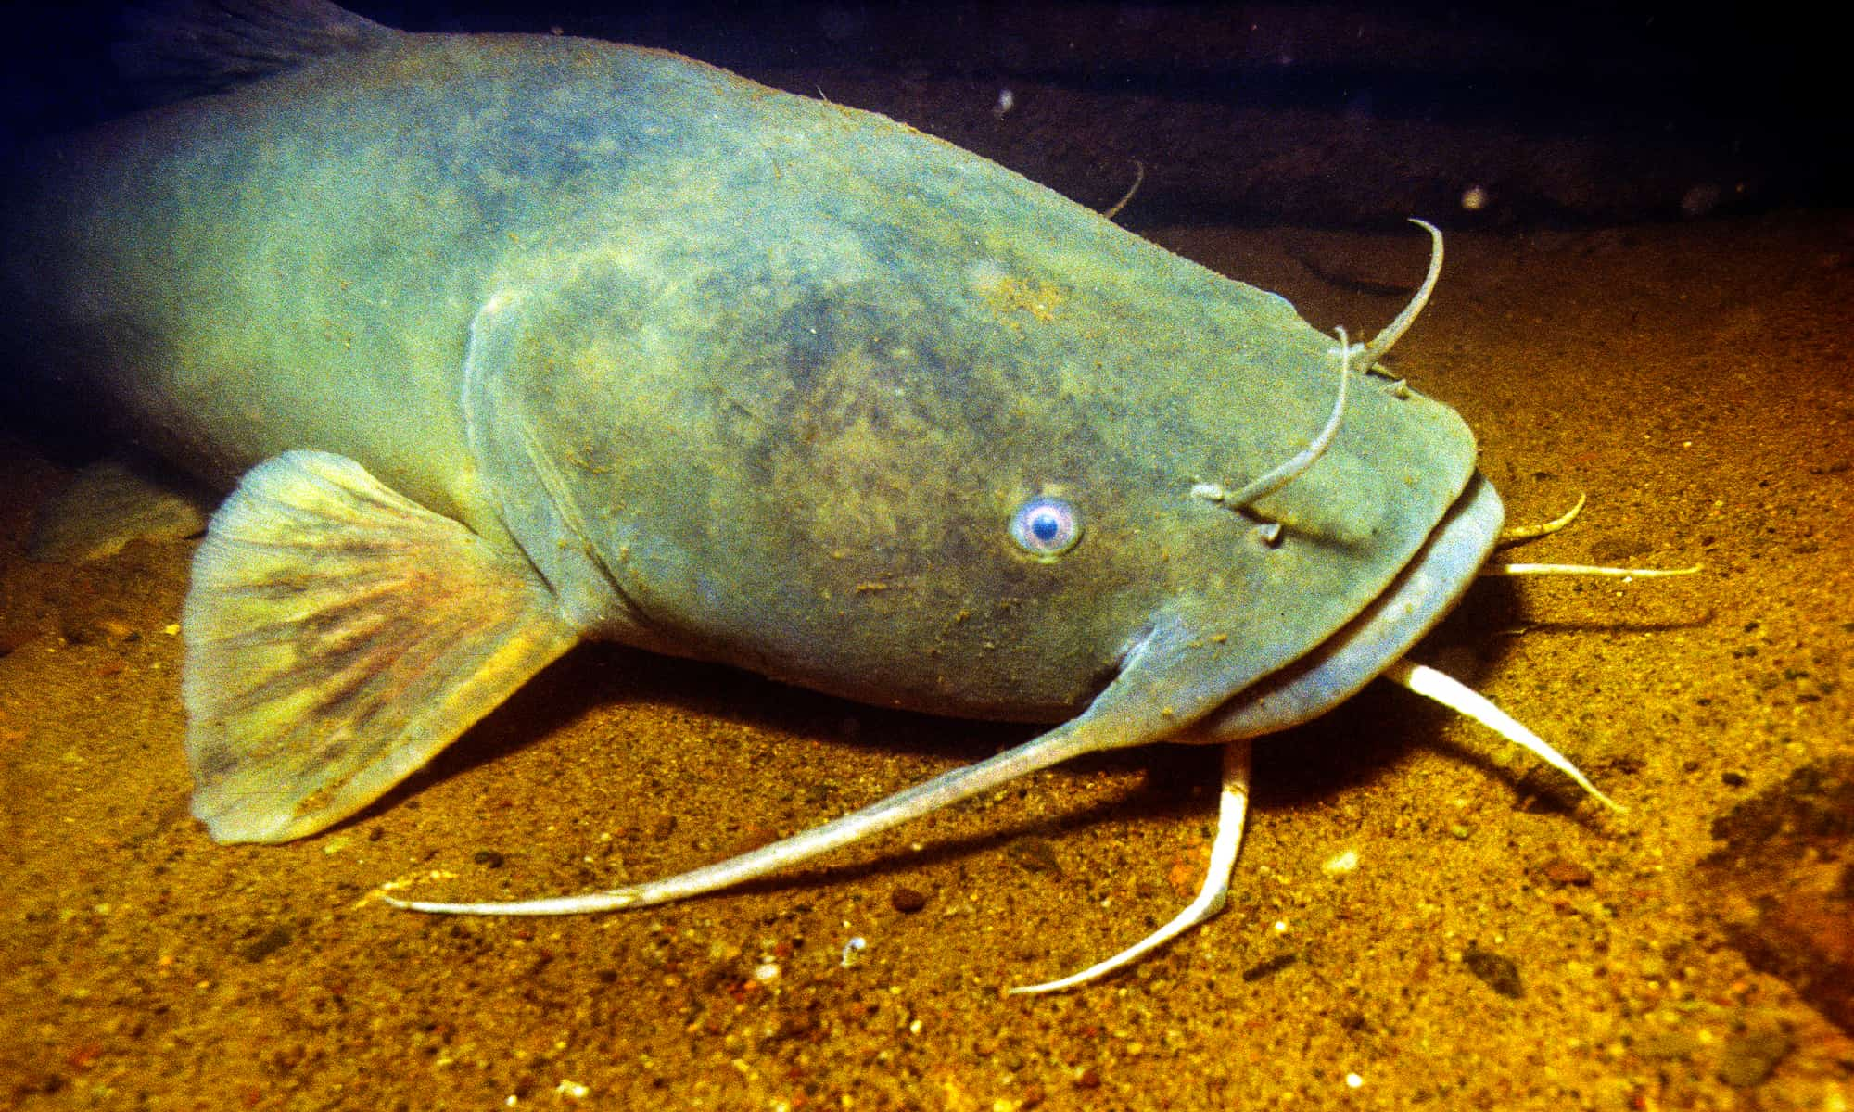
Catfish
Catfish are hardy freshwater fish that are raised in ponds and tanks. They are known for their whisker-like barbels and are popular for aquaculture and recreational fishing.
Temperature in the range of 24-32°C.
Dissolved oxygen(DO) level is below 3mg/L
pH to be in the range of 6.5 to 7.5

Slide 9
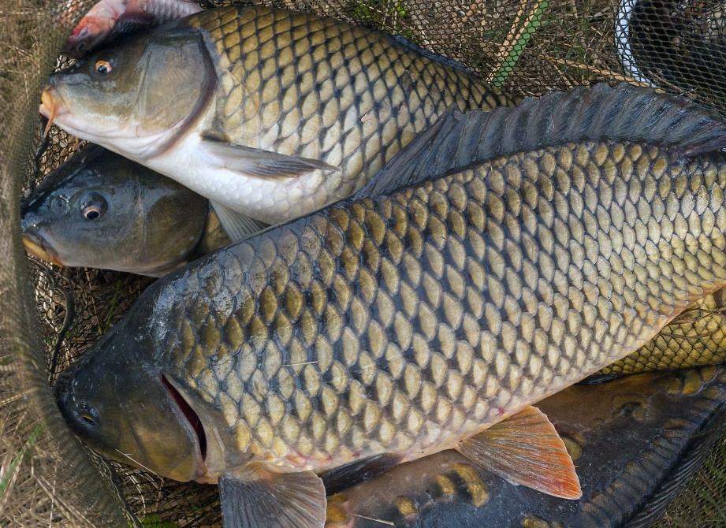
Carp
Carp is a group of fish species that includes common carp, grass carp, and others. They are omnivorous and can adapt to a variety of freshwater environments.
Temperature in the range of 15-22°C.
Dissolved oxygen(DO) level is below 2 mg/L
pH to be in the range of 7.5 to 8.0

Slide 10
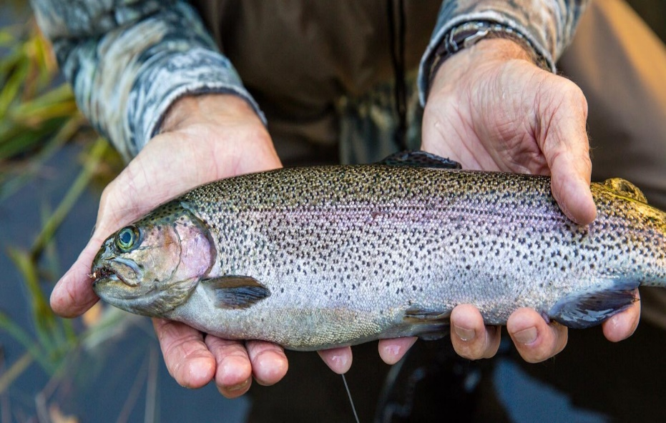
Trout
Trout, including rainbow trout and brown trout, are cold-water fish that thrive in streams, rivers, and lakes with clean, well-oxygenated water.
Temperature in the range of 15-22°C.
Dissolved oxygen(DO) level is below 2 mg/L
pH to be in the range of 7.5 to 8.0

Slide 11
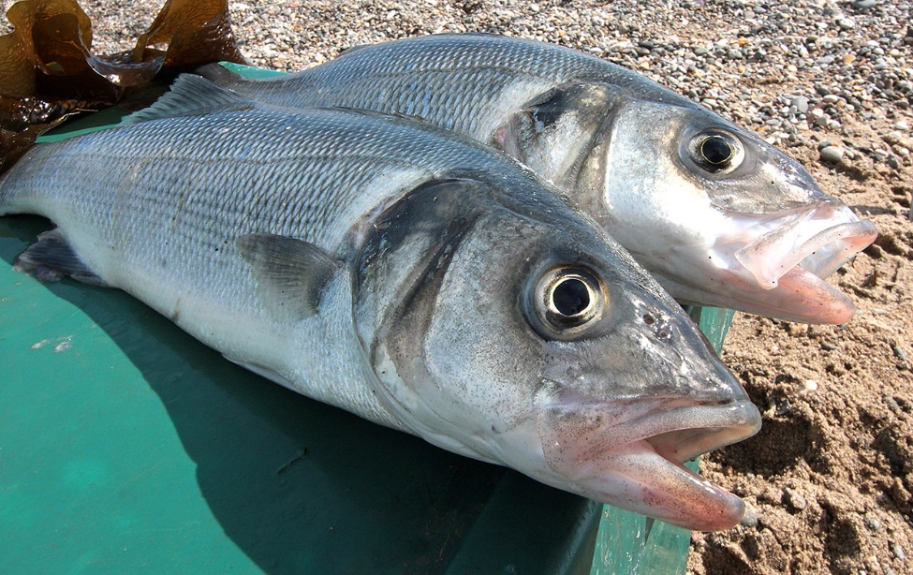
Bass fish
Bass, such as largemouth bass and smallmouth bass, are popular game fish found in freshwater lakes and rivers.
Temperature in the range of 18-20°C.
Dissolved oxygen(DO) level is above 5 mg/L
pH to be in the range of 6.5 to 8.5

Slide 12
THANK YOU

